Slide 1
Gradient descent
What it is?

Slide 2
What is gradient?
“A gradient measures how much the output of a function changes if you change the inputs a little bit.”
— Lex Fridman (MIT)
Measures the change in all weights with regard to the change in error.
Think of a gradient as the slope of a function.
The higher the gradient, the steeper the slope and the faster a model can learn.
But if the slope is zero, the model stops learning.
mathematically, a gradient is a partial derivative with respect to its inputs.

Slide 3
Why gradient descent?
why we need to use Gradient Descent if we can easily find the values with the OLS method?
B₁ = Correlation * (Std. Dev. of y/ Std. Dev. of x)
B₀ = Mean(Y) – B₁ * Mean(X)
computationally cheaper (faster) to find the solution using the gradient descent
formula looks very simple, even computationally, for univariate case.
In the multivariate case, the formulae is slightly more complicated and requires much more calculations

Slide 4
What is gradient descent
Gradient Descent is used while training a machine learning model.
It is an optimization algorithm, that tweaks it’s parameters iteratively to minimize a given function to its minimum.
It is simply used to find the values of a functions parameters (coefficients) that minimize a cost function as far as possible.
Start by defining the initial parameters values and from there on Gradient Descent iteratively adjusts the values, using calculus, so that they minimize the given cost-function.

Slide 5
usage
gradient descent is used in various ML models spanning from logistic regression, neural nets to deep learning algorithms
Ultimately, gradient descent, and transitively the gradient, are the blueprints that guide these models to converge on ideal weights.

Slide 6
Pre-reqs
Calculus
Derivatives and the Chain Rule (Calculus)
Partial Derivatives (Multivariate Calculus)
Vectors
Basic Vector Operations (Linear Algebra)
Objective Functions (Also called Loss Function)
Python
Basic Understanding of NumPy
plotting
firm understanding of the topics is very much required

Slide 7
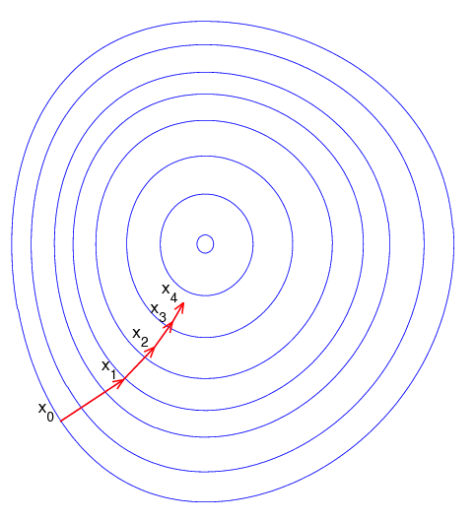
Example
Imagine a blindfolded man who wants to climb a hill, with the fewest steps possible.
He just starts climbing the hill by taking really big steps in the steepest direction, which he can do, as long as he is not close to the top.
As he comes further to the top, he will take smaller and smaller steps, since he doesn’t want to overshoot it.
This process can be described mathematically, using the gradient.

Slide 8
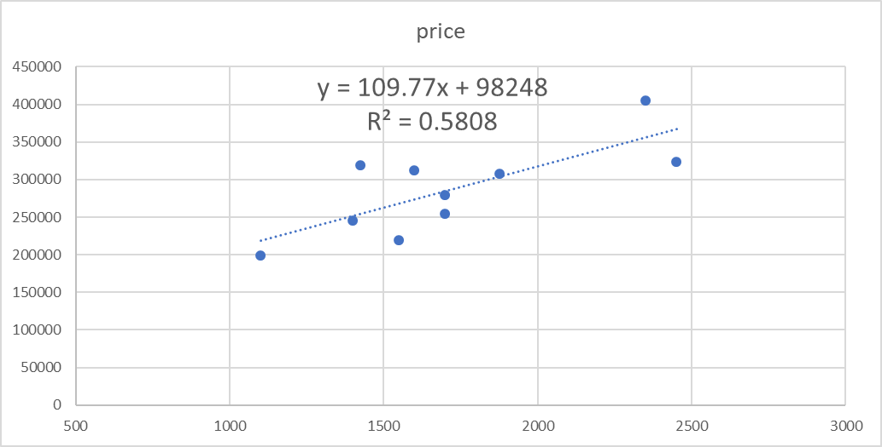
Example – linear regression
Example - predicting the price of a new house, from housing data:
Given historical housing data, the task is to create a model that predicts the price of a new house given the house size.
use a simple linear model, where we fit a line on the historical data, to predict the price of a new house (Y_{pred}) given its size (X)
Size | price
1400 | 245000
1600 | 312000
1700 | 279000
1875 | 308000
1100 | 199000
1550 | 219000
2350 | 405000
2450 | 324000
1425 | 319000
1700 | 255000

Slide 9
How does this work?
Y_{pred} = a + bX
The difference between Y_{actual} and Y_{pred} is the prediction error (E)
Need optimal values of a, b (called weights) that best fits the historical data by reducing the prediction error and improving prediction accuracy.
Sum of Squared Errors (SSE) = ½ SUM (Actual House Price – Predicted House Price)²
= ½ SUM (Y – Y_{pred})²

Slide 10
Steps to gradient descent
Step 1: Initialize the weights(a & b) with random values and calculate Error (SSE)
Step 2: Calculate the gradient i.e. change in SSE when the weights (a & b) are changed by a very small value from their original randomly initialized value.
This helps us move the values of a & b in the direction in which SSE is minimized.
Step 3: Adjust the weights with the gradients to reach the optimal values where SSE is minimized
Step 4: Use the new weights for prediction and to calculate the new SSE
Step 5: Repeat steps 2 and 3 till further adjustments to weights doesn’t significantly reduce the Error

Slide 11
details
Size | price | Std X | Std Y | a | b | Y=a + bX | SSE=1/2(y-y')^2 | ∂SSE/∂a = – (Y - Y') | ∂SSE/∂b = – (Y - Y')X
1400 | 245000 | 0.222222222 | 0.223300971 | 0.45 | 0.75 | 0.616666667 | 0.077368285 | 0.393365696 | 0.087414599
1600 | 312000 | 0.37037037 | 0.548543689 |  |  | 0.727777778 | 0.016062429 | 0.179234088 | 0.066382996
1700 | 279000 | 0.444444444 | 0.388349515 |  |  | 0.783333333 | 0.078006109 | 0.394983819 | 0.175548364
1875 | 308000 | 0.574074074 | 0.529126214 |  |  | 0.880555556 | 0.061751291 | 0.351429342 | 0.201746474
1100 | 199000 | 0 | 0 |  |  | 0.45 | 0.10125 | 0.45 | 0
1550 | 219000 | 0.333333333 | 0.097087379 |  |  | 0.7 | 0.181751814 | 0.602912621 | 0.200970874
2350 | 405000 | 0.925925926 | 1 |  |  | 1.144444444 | 0.010432099 | 0.144444444 | 0.133744856
2450 | 324000 | 1 | 0.606796117 |  |  | 1.2 | 0.175945424 | 0.593203883 | 0.593203883
1425 | 319000 | 0.240740741 | 0.582524272 |  |  | 0.630555556 | 0.001153502 | 0.048031284 | 0.011563087
1700 | 255000 | 0.444444444 | 0.27184466 |  |  | 0.783333333 | 0.130810331 | 0.511488673 | 0.227328299
 |  |  |  |  |  |  | 0.834531285 | 3.669093851 | 1.697903432
Step 1: start off with random values of a and b and calculate prediction error (SSE)
Step 2: Calculate the error gradient w.r.t the weights
∂SSE/∂a = – (Y - Y_{P}), ∂SSE/∂b = – (Y - Y_{P})X
Step 3: Adjust the weights with the gradients to reach the optimal values where SSE is minimized
Step 4: Use new a and b for prediction and to calculate new Total SSE
Step 5: Repeat step 3 and 4 till the time further adjustments to a, b doesn’t significantly reduces the error.

Slide 12
Types of gradient descent
Batch Gradient Descent | Stochastic Gradient Descent | Mini Batch Gradient Descent
Vanilla gradient descent | SGD
calculates the error for each example within the training dataset | Update the model for each training example within the dataset | combination of the concepts of SGD and Batch Gradient Descent.
requires that the entire training dataset is in memory | frequent updates allow us to have a pretty detailed rate of improvement | splits the training dataset into small batches
model gets updated only after all training examples have been evaluated | computationally expensive | performs an update for each of these batches
used for Off line learning Linear regression - Housing prices prediction, Logistic regression - Spam detection in mail and text messages | Faster getting the co-eff

Slide 13
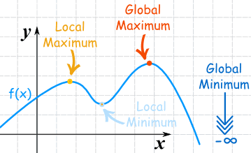
Local and global minima
A maximum or minimum is said to be local if it is the largest or smallest value of the function, respectively, within a given range.
However, a maximum or minimum is said to be global if it is the largest or smallest value of the function, respectively, on the entire domain of a function.
There is only one global maximum (and one global minimum) but there can be more than one local maximum or minimum.

Slide 14
Learning rate
Learning rate is a hyper-parameter that controls how much we are adjusting the weights of our model with respect the loss gradient.
The lower the value, the slower we travel along the downward slope.
While this might be a good idea (using a low learning rate) in terms of making sure that we do not miss any local minima, it could also mean a long time to converge
new_weight = existing_weight — learning_rate * gradient

Slide 15
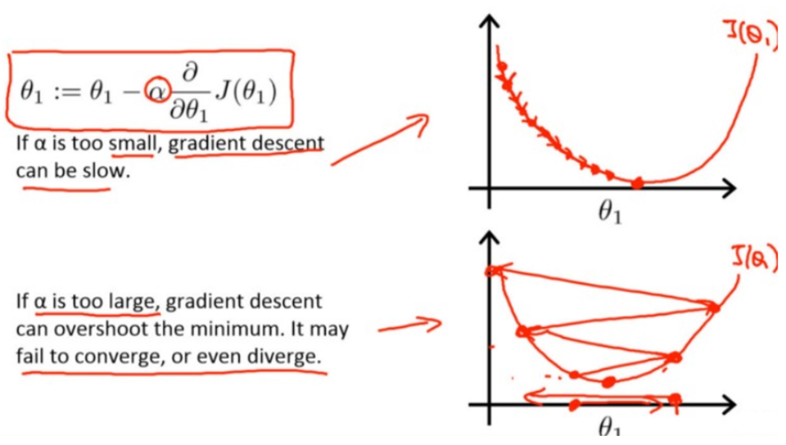
Learning rate
learning rates are configured naively at random by the user.
past experiences
often hard to get it right
Gradient descent with small (top) and large (bottom) learning rates.

Slide 16
Stochastic Gradient Descent (SGD)
gradient descent algorithm will run very slowly on large datasets.
The reason for this “slowness” is because each iteration of gradient descent computes a prediction for each training point in the training data.
For image datasets such as ImageNet where we have over 1.2 million training images, this computation can take a long time.
SGD - computes the gradient and updates our weight matrix W on small batches of training data, rather than the entire training set itself.

